Slide 1
DT & RF
Classification Evaluation

Slide 2
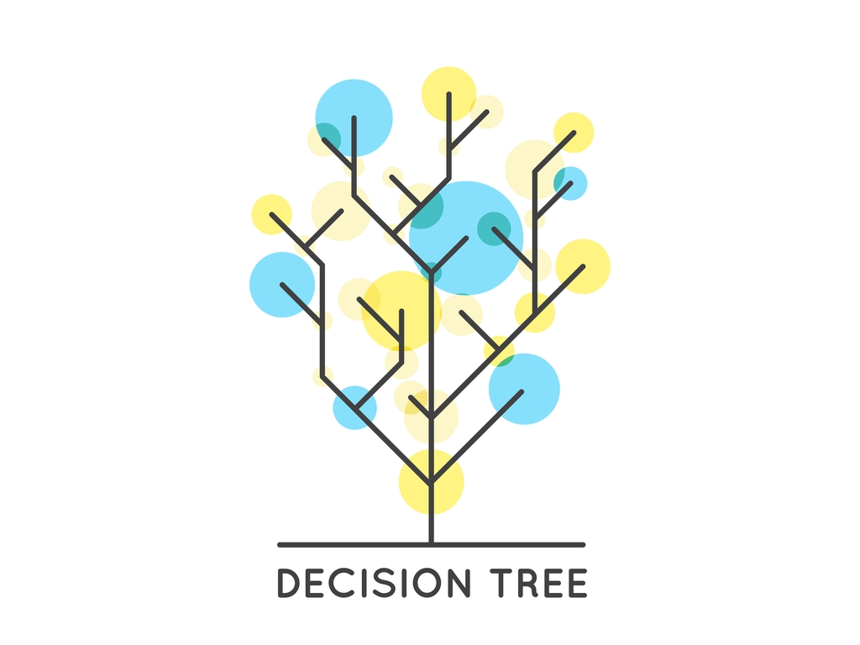

Slide 3

What is decision tree?
A decision tree is a tree where each node represents a feature(attribute)
each link (branch) represents a decision(rule)
each leaf represents an outcome (categorical or continuous value).

Slide 4
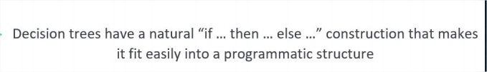
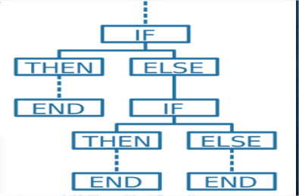
Decision Tree

Slide 5
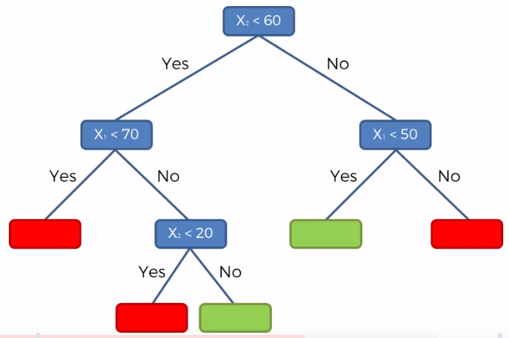
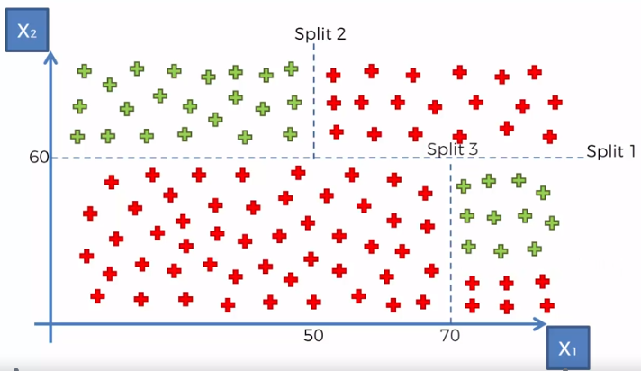
How it works in classification?

Slide 6
Classification using the ID3 algorithm.
This is a binary classification problem, let’s build the tree using the ID3 algorithm
To create a tree, we need to have a root node first and we know that nodes are
so which one do we need to pick first?
Answer: determine the attribute that best classifies the training data; use this attribute at the root of the tree. Repeat this process at for each branch.
This means we are performing top-down, greedy search through the space of possible decision trees.

Slide 7
Okay so how to build this?
There are couple of algorithms there to build a decision tree , we only talk about a few which are
CART (Classification and Regression Trees) → uses Gini Index(Classification) as metric.
ID3 (Iterative Dichotomiser 3) → uses Entropy function and Information gain as metrics.

Slide 8
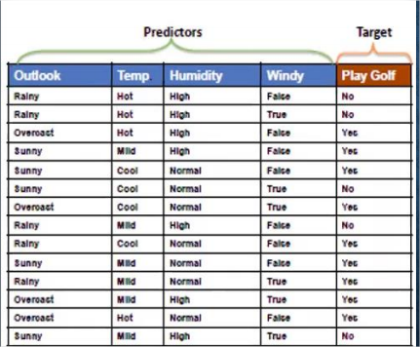
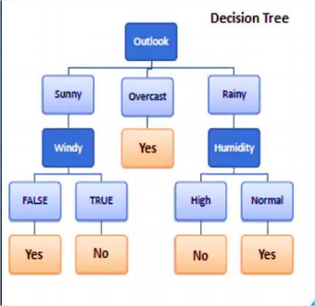

Slide 9
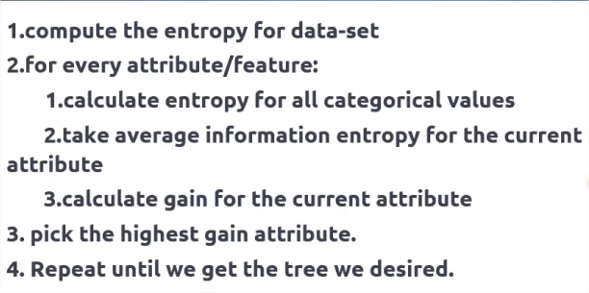
How To build Decision Tree:

Slide 10
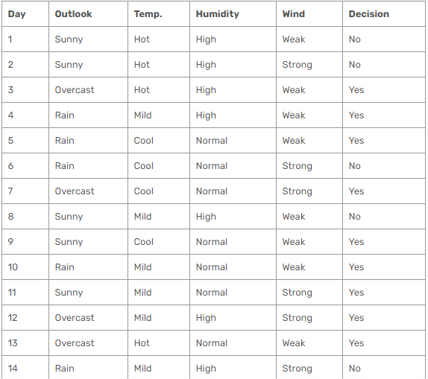
Step 1

Slide 11
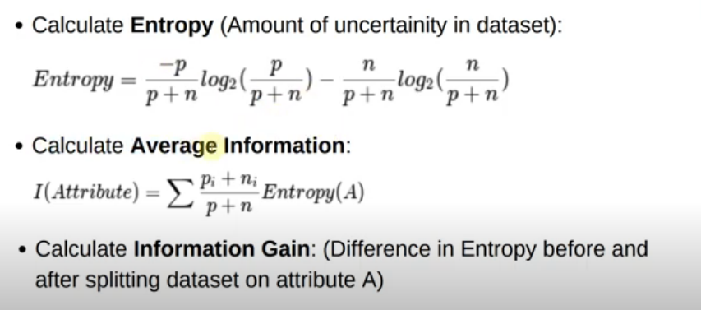

Slide 12
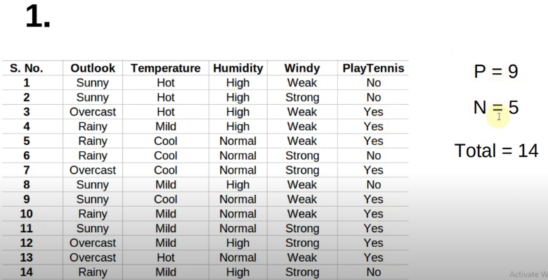

Slide 13
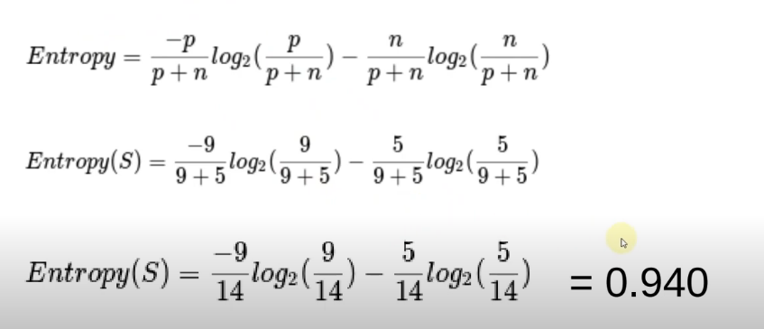

Slide 14
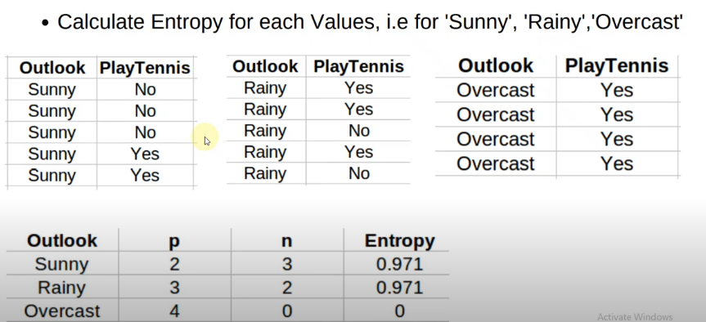

Slide 15
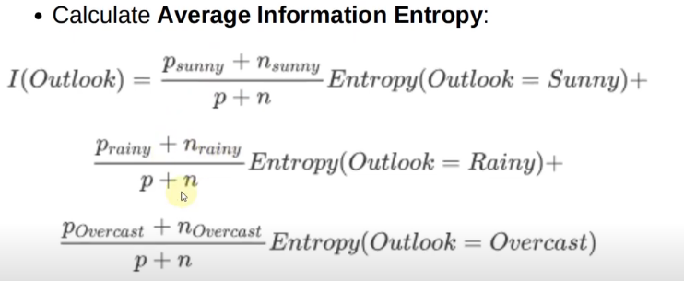
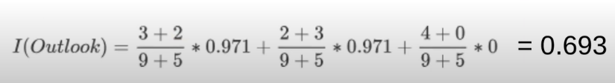

Slide 16
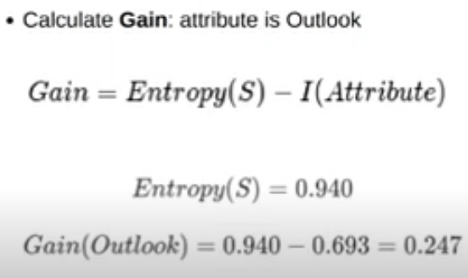

Slide 17
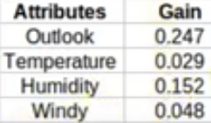
Root Node is Outlook has high Gain

Slide 18
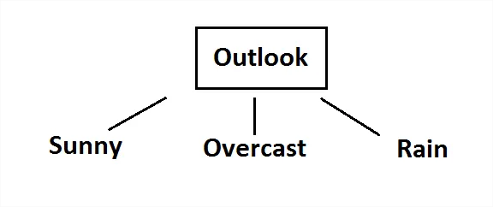
Now, we need to test dataset for custom subsets of outlook attribute.

Slide 19
Example: Get Entropy for Outlook
-Get Entropy for each level in the column
E(outlook = Sunny) = -⅖ log ⅖ - ⅗ log ⅗ = 0.971
E(outlook = overcast) = -1 log 1 - 0 log 0 = 0
E(outlook = rainy) = -⅗ log ⅗ - ⅖ log ⅖ = 0.971

Slide 20
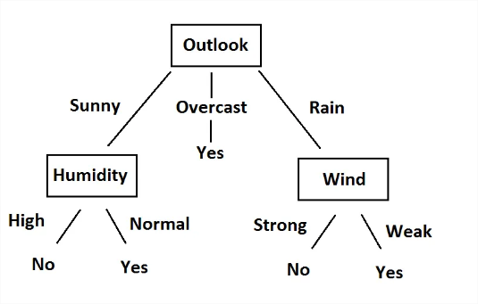
Final Decision tree

Slide 21
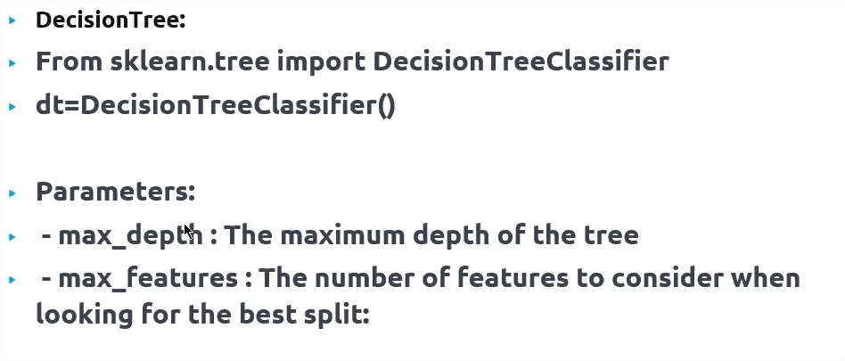
Code

Slide 22
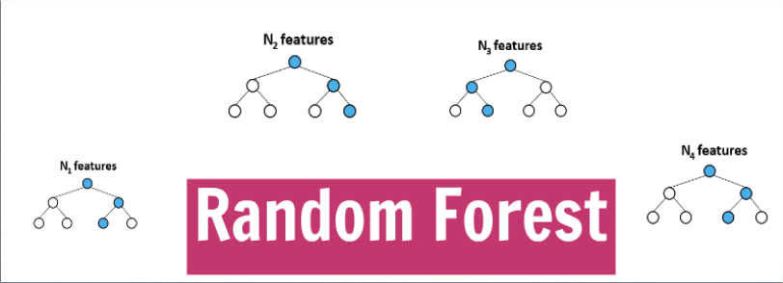

Slide 23
WHAT IS RANDOM FOREST?
Random forest (or random forests) is an ensemble classifier that consists of many decision trees and outputs the class that is the mode of the class's output by individual trees.

Slide 24
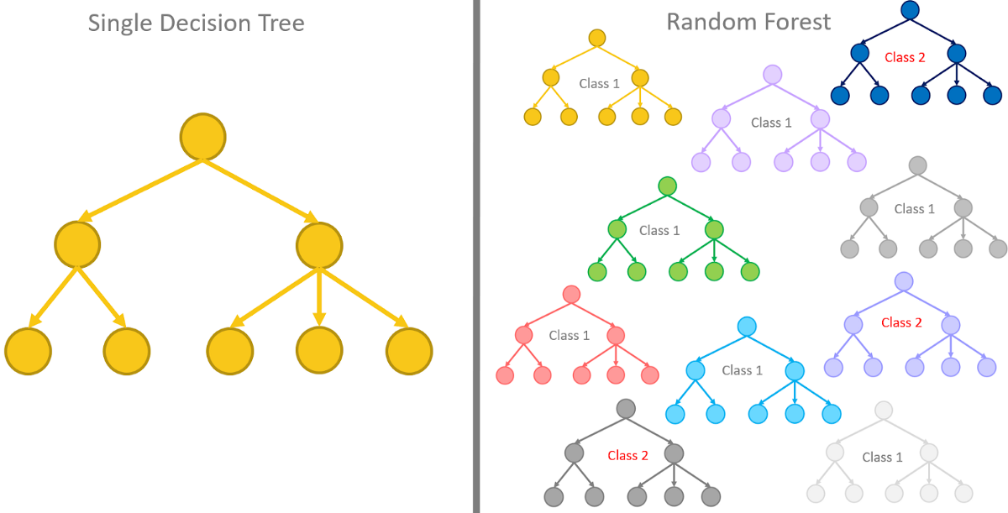
Ensample Model
Combine (or ensemble) the models you have already seen in a way that makes the combination of these models better at predicting than the individual models.
Examples:
Random Forests.
Ada Boost.
XGBoost.

Slide 25
Code

